Slide 1
Data Structure
Lab no.-2
Aim:- Implement sparse matrix using array.

Slide 2
Sparse Matrix
A matrix is a two-dimensional data object made of m rows and n columns, therefore having total m x n values. If most of the elements of the matrix have 0 value, then it is called a sparse matrix.
Advantage of Sparse Matrix:
▪ Storage: There are lesser non-zero elements than zeros
and thus lesser memory can be used to store only
those elements.
▪ Computing time: Computing time can be saved by
logically designing a data structure traversing only non-
zero elements

Slide 3
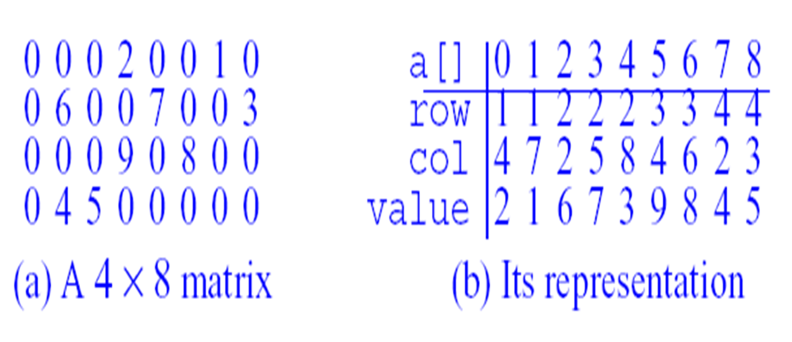
Representation of Sparse Matrix

Slide 4
Pseudo code
int main()
{
// Assume 4x5 sparse matrix
int sparseMatrix[4][5] =
{
{0 , 0 , 3 , 0 , 4 },
{0 , 0 , 5 , 7 , 0 },
{0 , 0 , 0 , 0 , 0 },
{0 , 2 , 6 , 0 , 0 }
};
int size = 0;
for (int i = 0; i < 4; i++)
for (int j = 0; j < 5; j++)
if (sparseMatrix[i][j] != 0)
size++;

Slide 5
// number of columns in compactMatrix (size) must be
// equal to number of non - zero elements in
// sparseMatrix
int compactMatrix[3][size];
// Making of new matrix
int k = 0;
for (int i = 0; i < 4; i++)
for (int j = 0; j < 5; j++)
if (sparseMatrix[i][j] != 0)
{
compactMatrix[0][k] = i;
compactMatrix[1][k] = j;

Slide 6
compactMatrix[2][k] = sparseMatrix[i][j];
k++;
}
for (int i=0; i<3; i++)
{
for (int j=0; j<size; j++)
printf("%d ", compactMatrix[i][j]);
printf("\n");
}
return 0;
}

Slide 7
Output
Input:
0 , 0 , 3 , 0 , 4
0 , 0 , 5 , 7 , 0
0 , 0 , 0 , 0 , 0
0 , 2 , 6 , 0 , 0
Output:
0 0 1 1 3 3
2 4 2 3 1 2
3 4 5 7 2 6

Slide 8
Viva - Questions
Q1. What is sparse matrix?
Q2. What are the different ways of
representing sparse matrix in memory?
Q3. What is the advantage of representing
only non-zero values in sparse matrix?
Q4. Which data structure is used to
implement a matrix?
Q5. What are various types of representation
of matrix?

